Slide 1
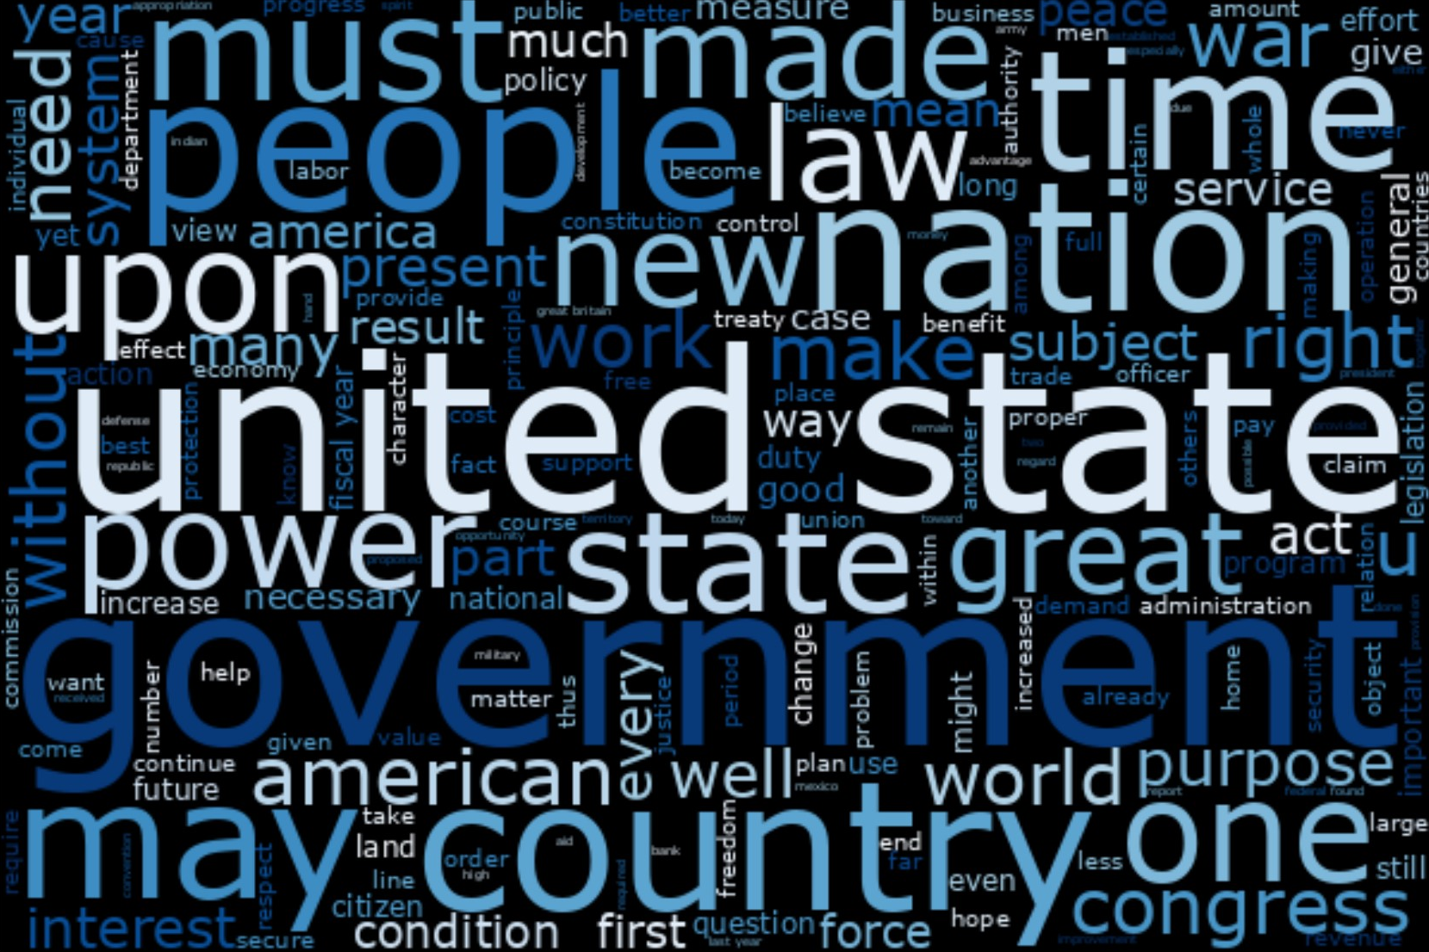
Presidential Sentiment Analysis
MSDS 692
Project by
Jeremy Beard

Slide 2
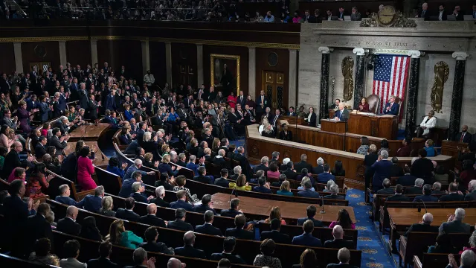
Presentation Flow
Introduction
Methods and Approach
Results
Conclusion
Future Work
References

Slide 3
Introduction
How differently do the presidents speak?
How can we measure the differences between speeches?

Slide 4
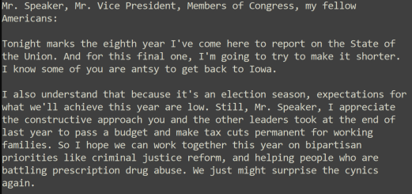
Introduction
Project centered around State of the Union speeches!
State of the Union speeches all the way back to George Washington!
In .txt format
Utilize natural language processing techniques
Points of Curiosity
How do the presidents speak during the State of the Union??
What topics did each president speak about??
More questions listed on later slides

Slide 5
Why?

Slide 6
Why?
Why research presidents?
Very little business case for it…what’s the ‘problem’?
Historical significance!
Text Analytics was something I had fun with throughout my studies
Curiosity!
Learning!

Slide 7
Methods and Approach
Natural language processing techniques used:
Filtering out symbols, punctuation
Removing stopwords
Removing any words with 2 characters or less
Performed lemmatization
Feature creation
Speech substance
1-grams, 2-grams, 3-grams
Unique word count (vocabulary count)
Sentiment analysis
Polarity found using 2 different approaches
File-based key approach, TextBlob approach
Subjectivity
Goals:
Which presidents gave the longest speeches?
Which presidents gave the shortest speeches?
Which presidents used the most unique words?
Which presidents used the least unique words?
Which presidents use the widest variety of words?
What is the quantitative positive/negative sentiment between all the speeches?
What is the quantitative positive/negative sentiment between all the presidents?
What are the themes or buzzwords among the different speeches / presidents?
What were the most common words used in each speech?

Slide 8
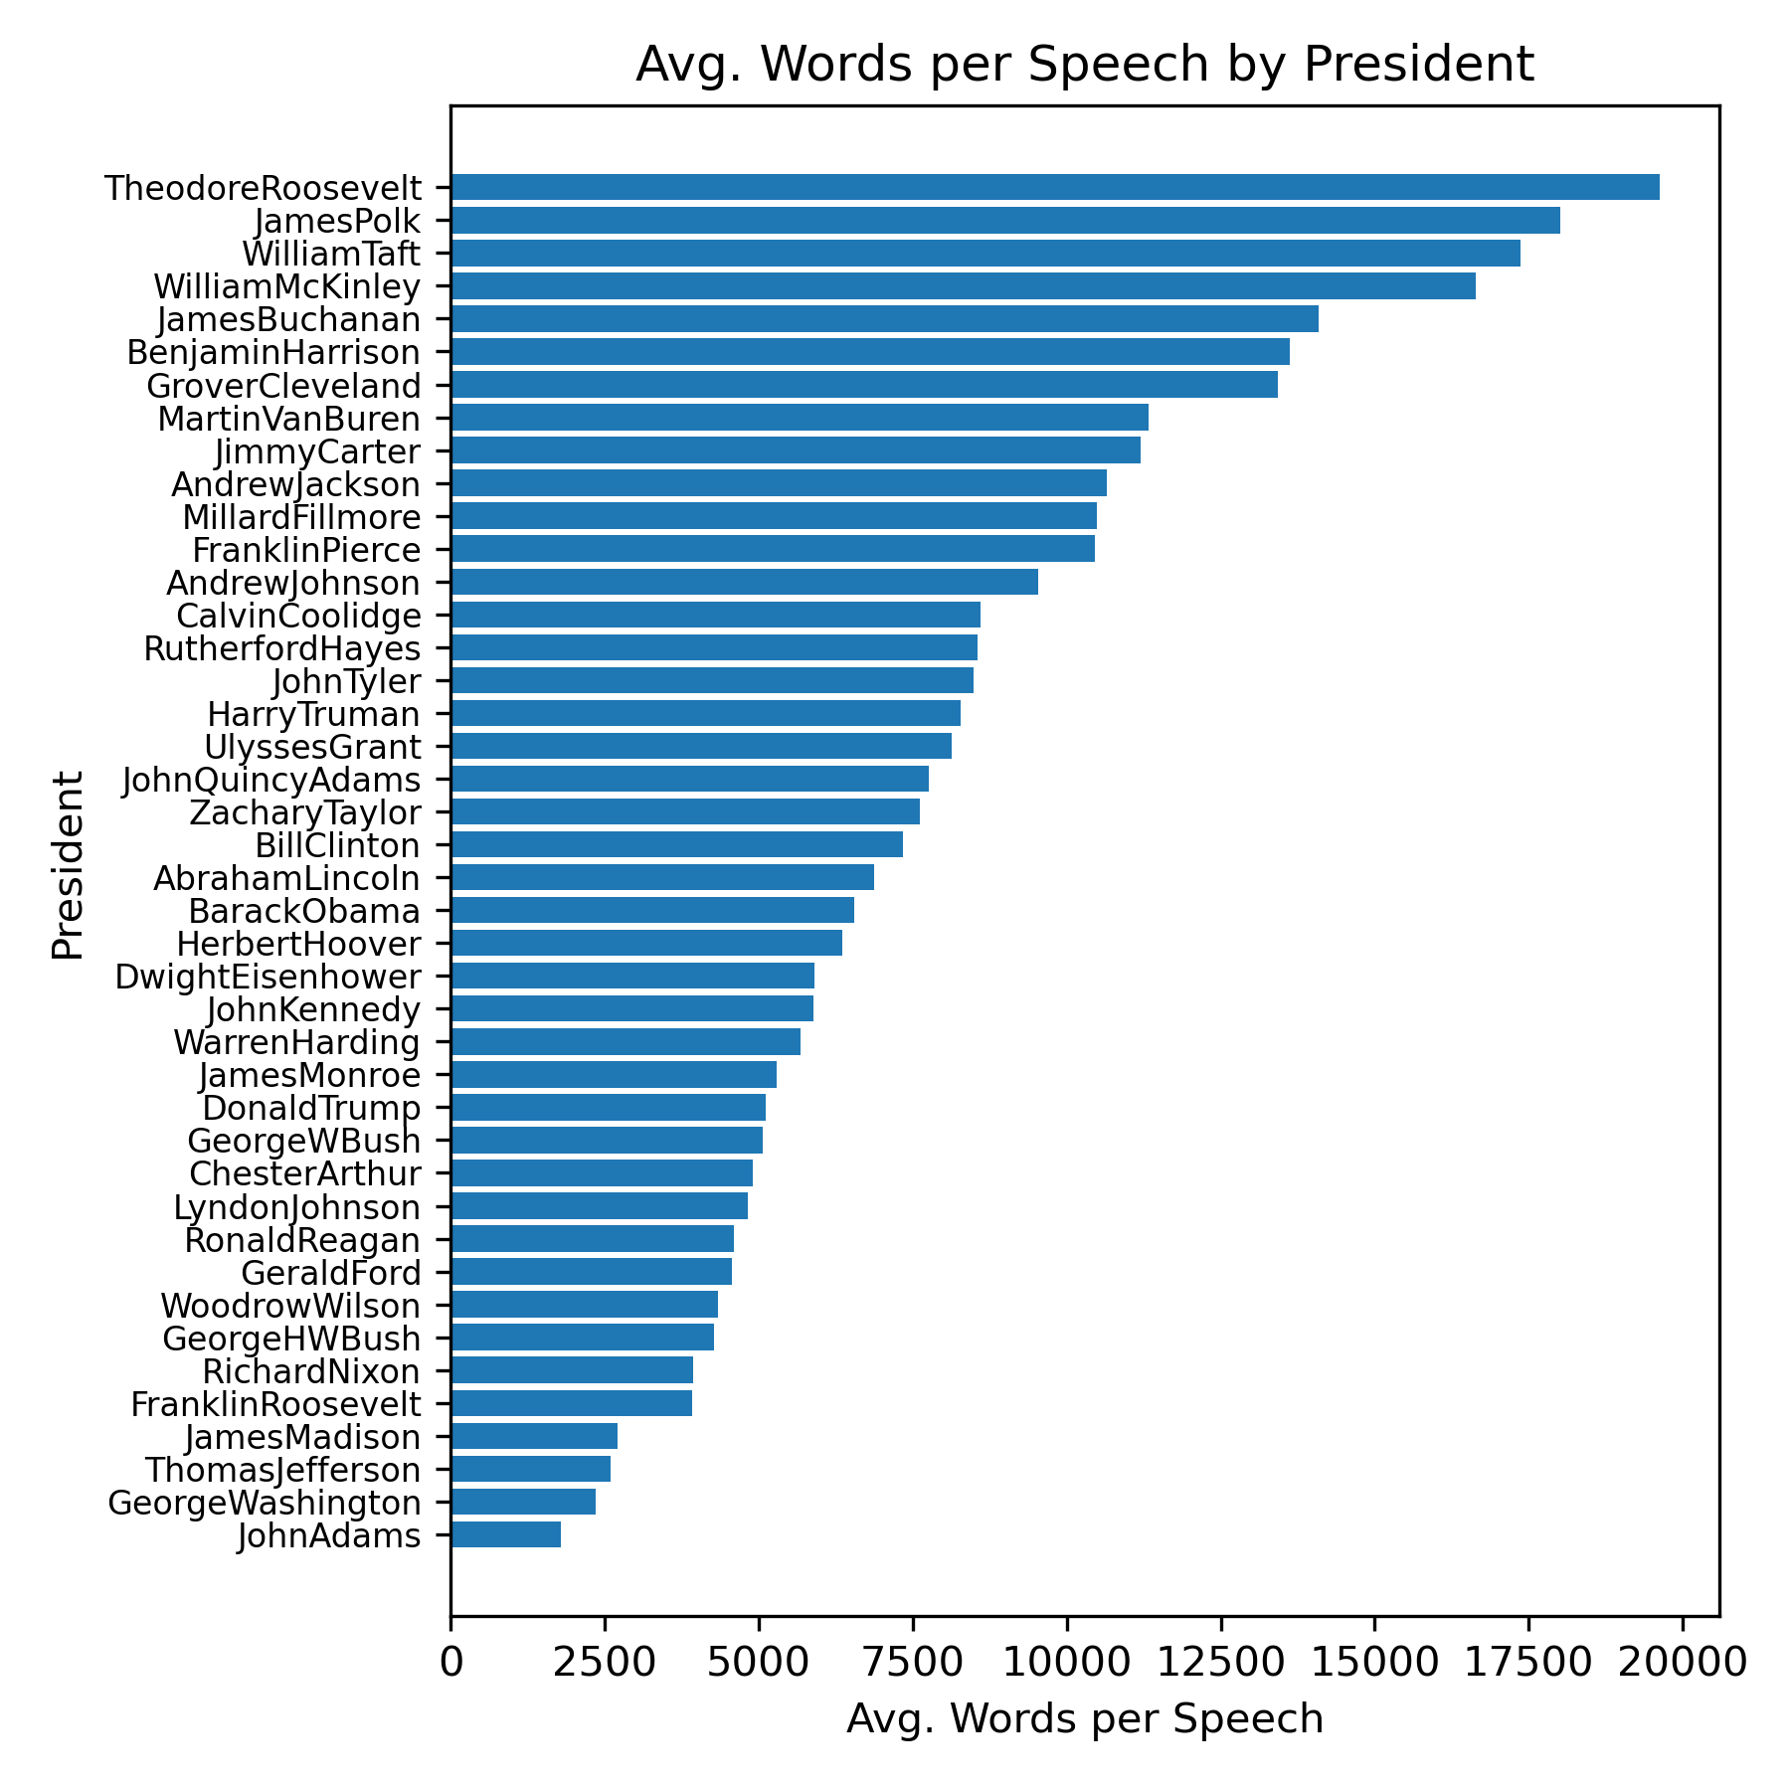
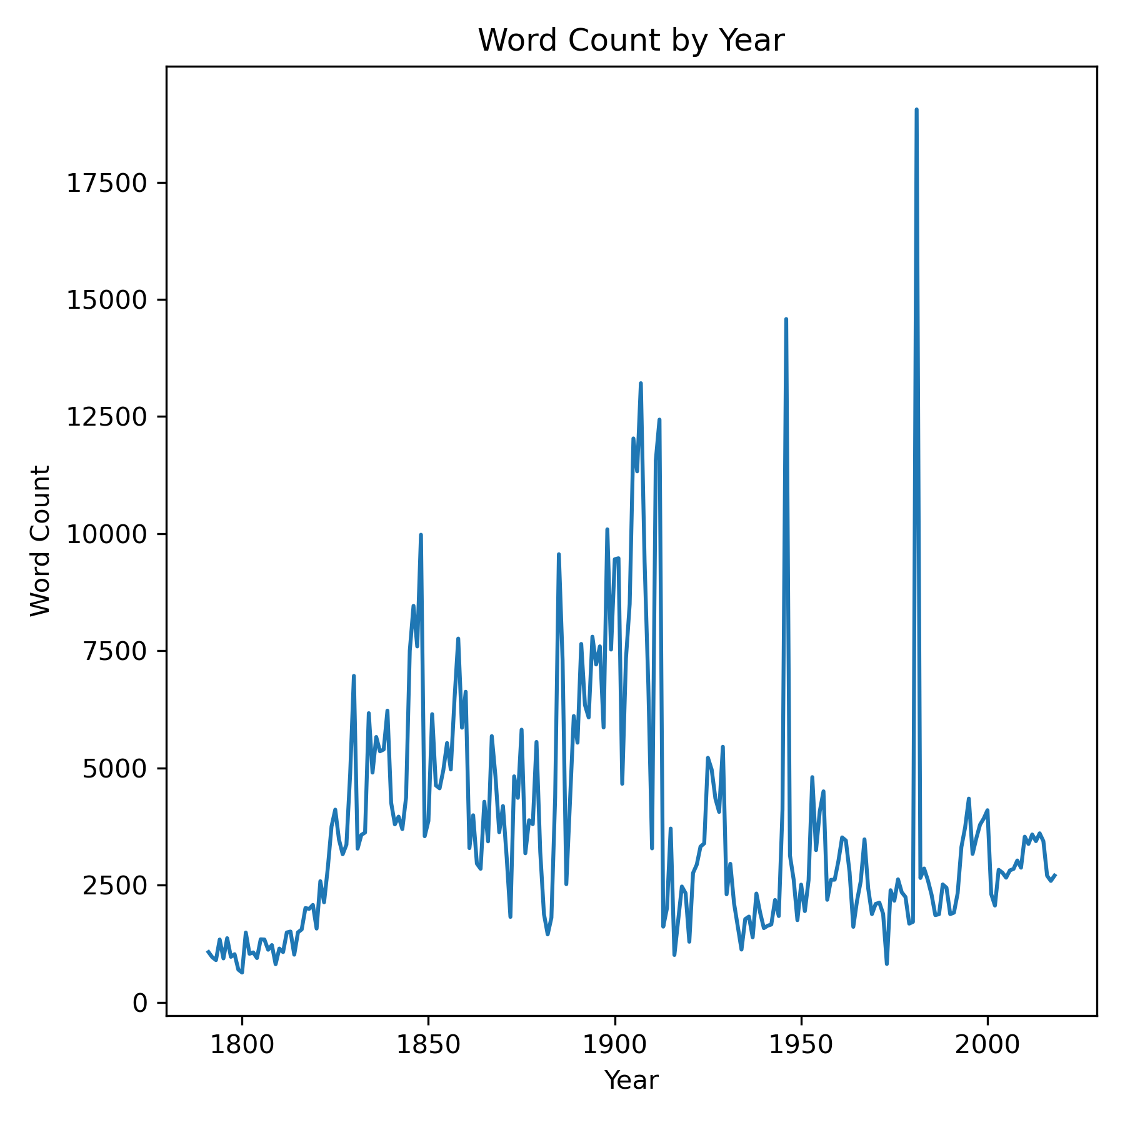
Results
Which presidents gave the longest speeches?
Theodore Roosevelt takes the cake!
A lot of people around 1900 were very talkative
Which presidents gave the shortest speeches?
The early days of America didn’t have much to talk about ☺

Slide 9
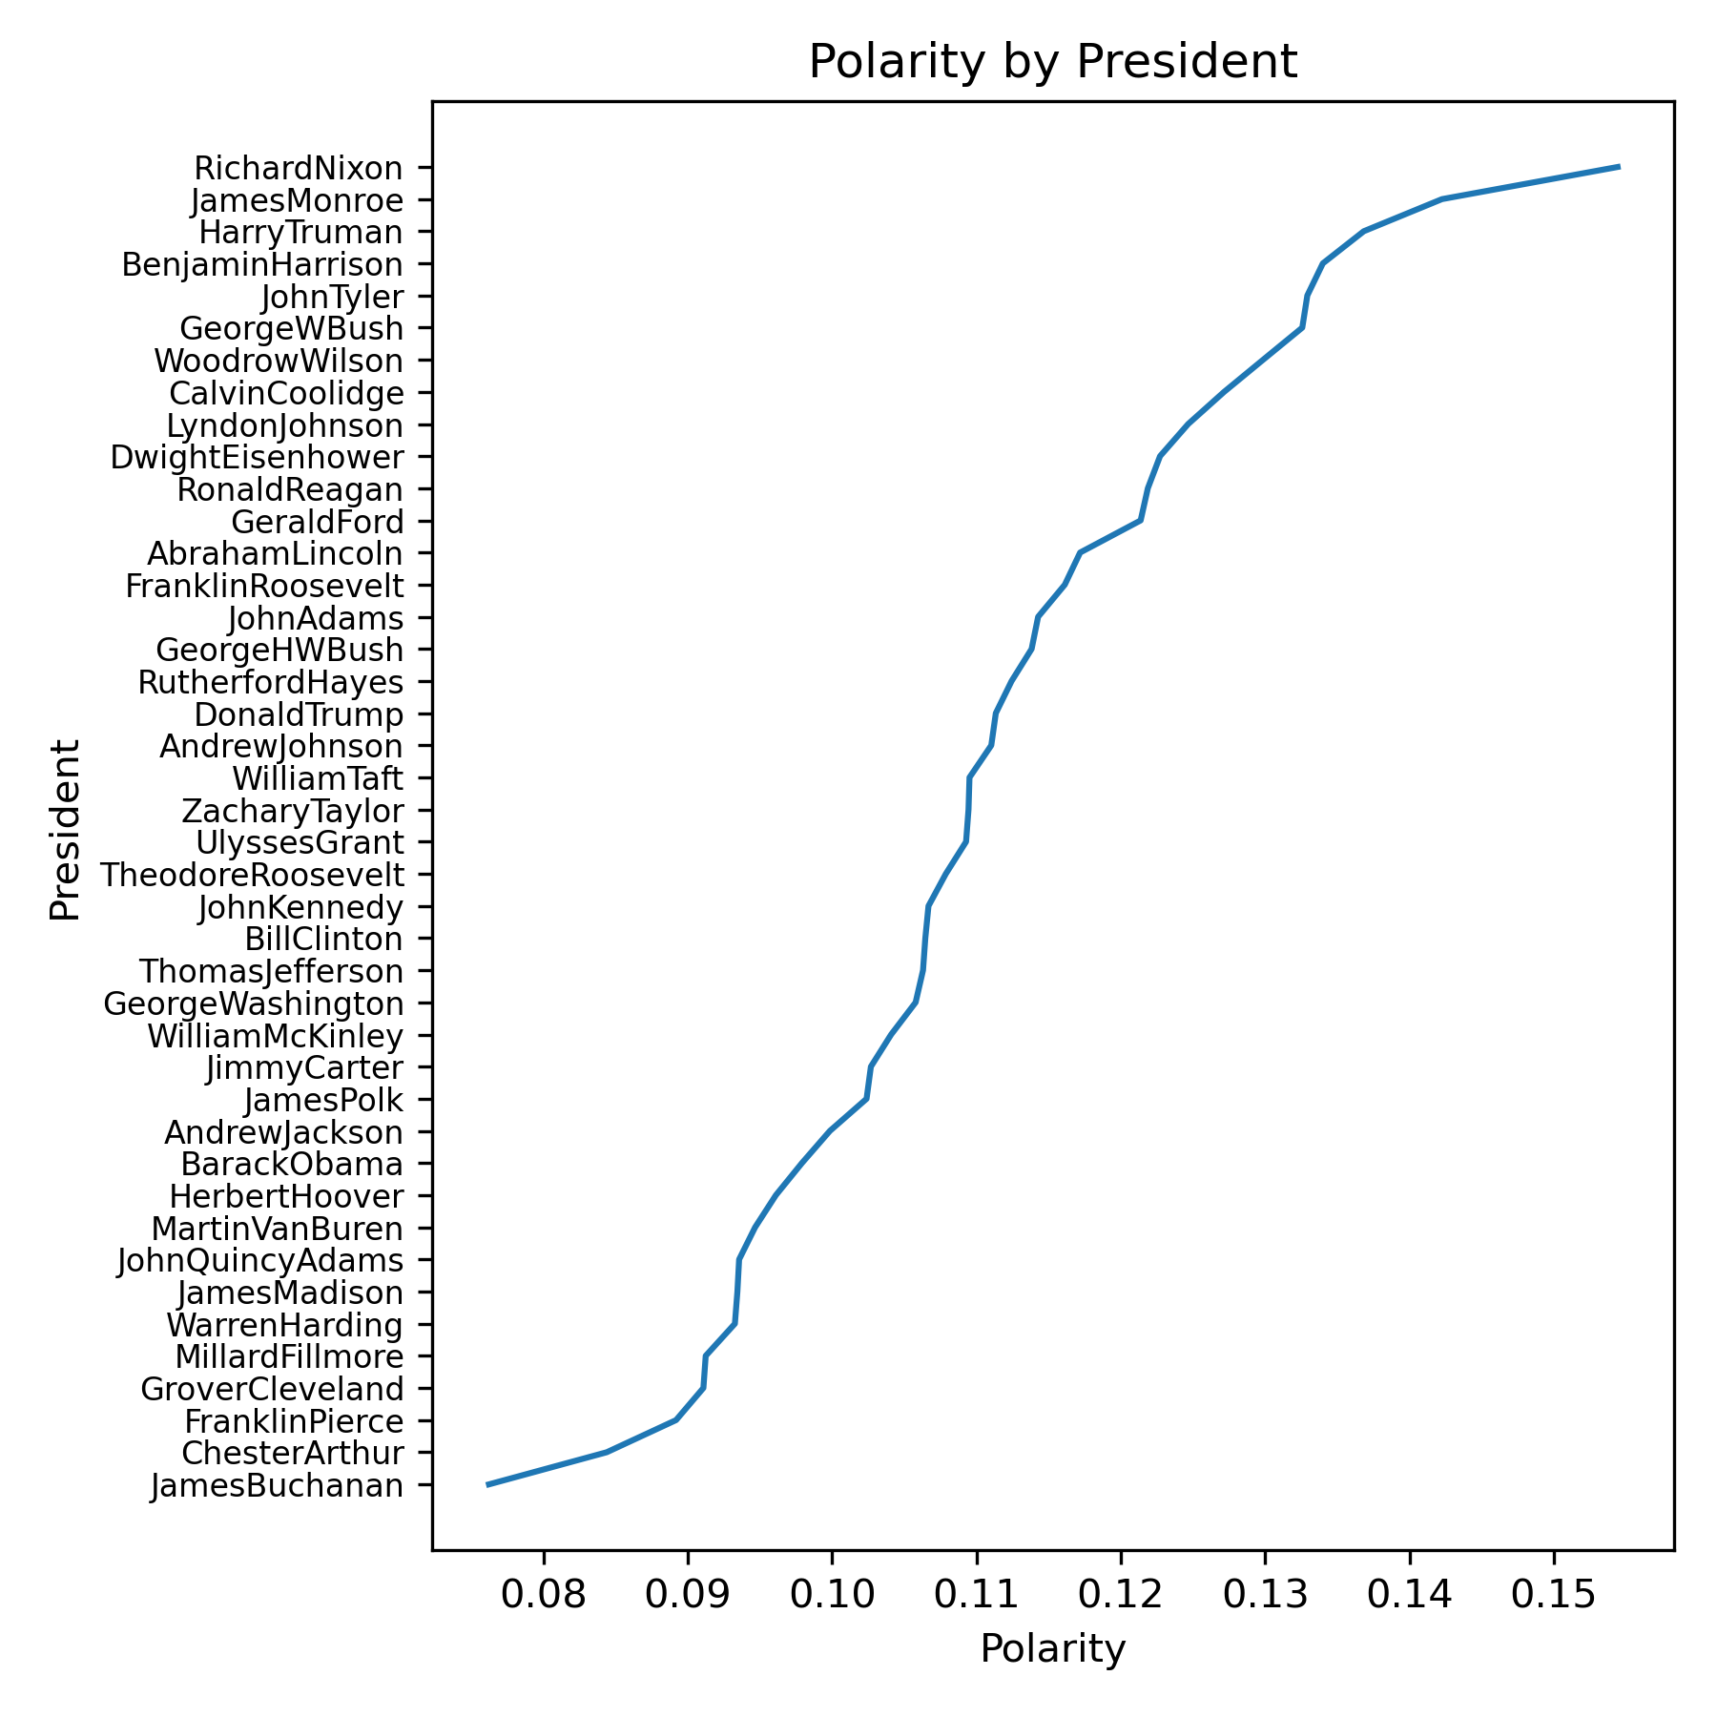
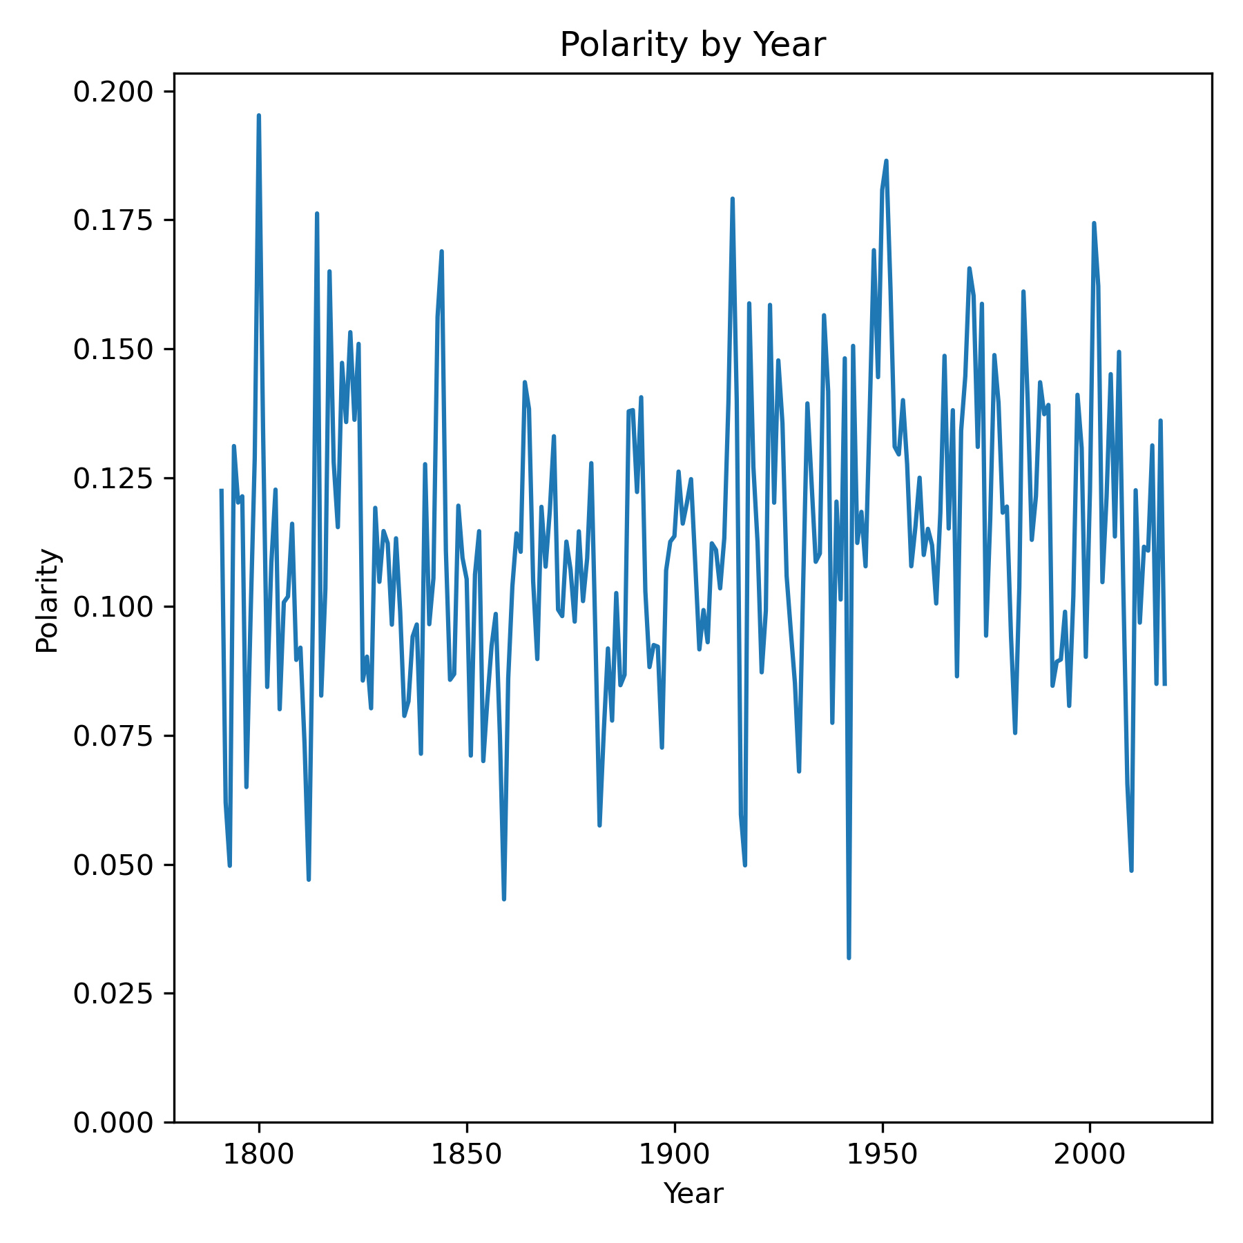
Results
What is the quantitative positive/negative sentiment between all the speeches?
Generally positive polarity!
Messy chart on right, but shows an uptick in polarity after WWII
Seems to be on a downward trend at-present
What is the quantitative positive/negative sentiment between all the presidents?
Nixon, Eisenhower, Reagan, Monroe all positive
Buchanan, Cleveland, Pierce, Obama more negative
Recent Republicans seem to be more positive than recent Democrats

Slide 10
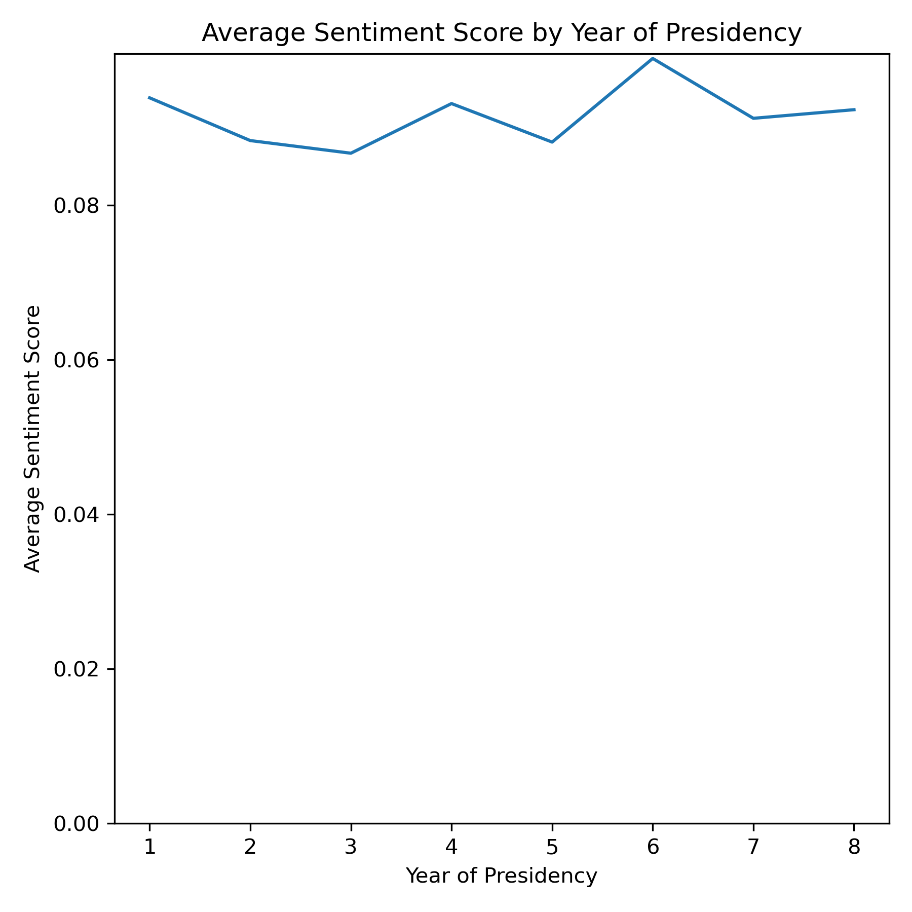
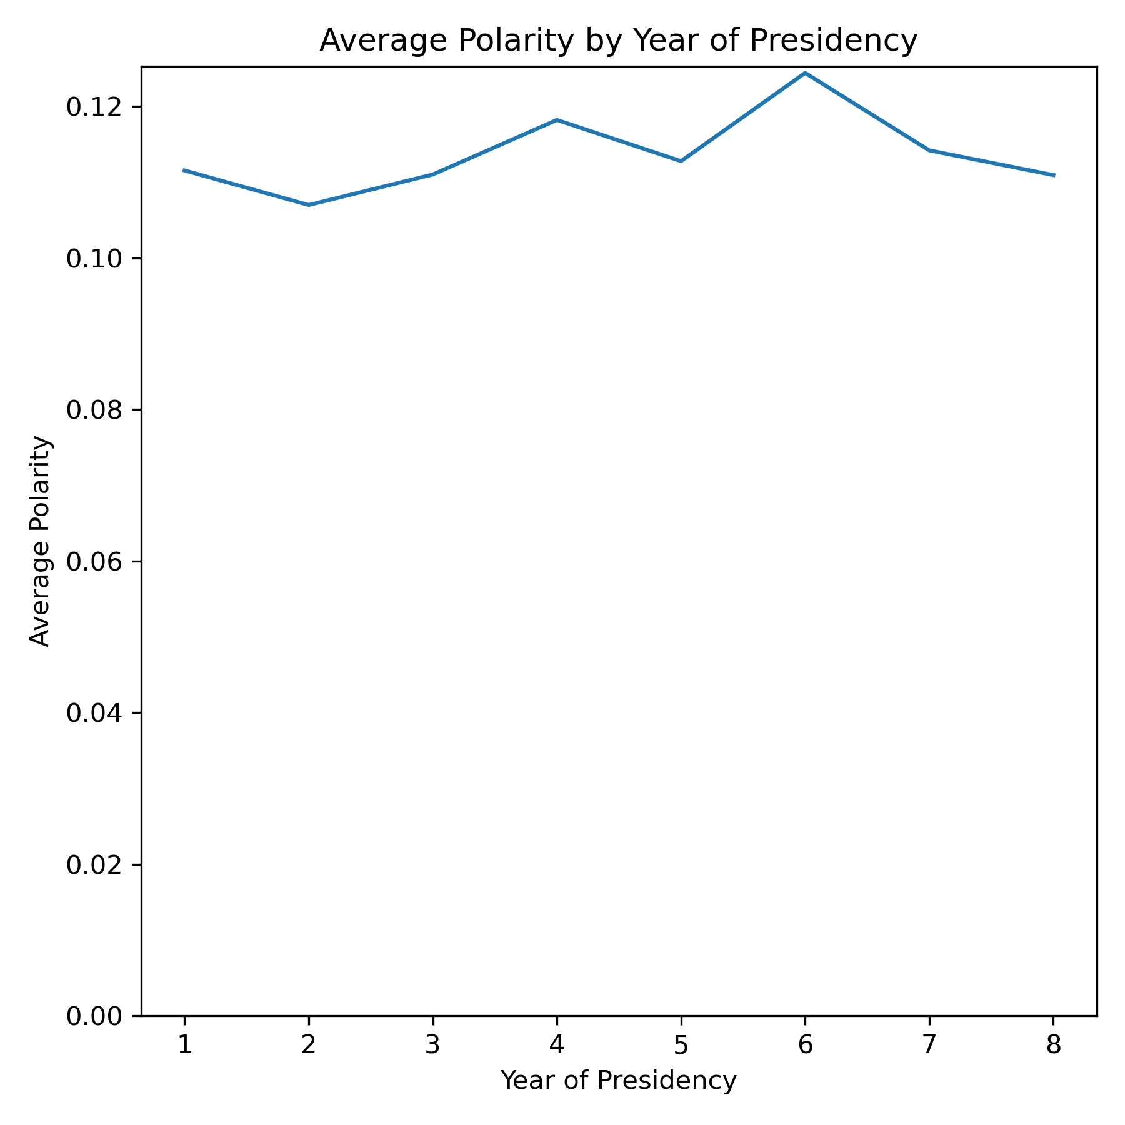
Results
How does the average sentiment change throughout a president’s term?
Mostly consistent, with a spike at year 6
Victory lap?
Lowest sentiment/polarity around year 2-3

Slide 11
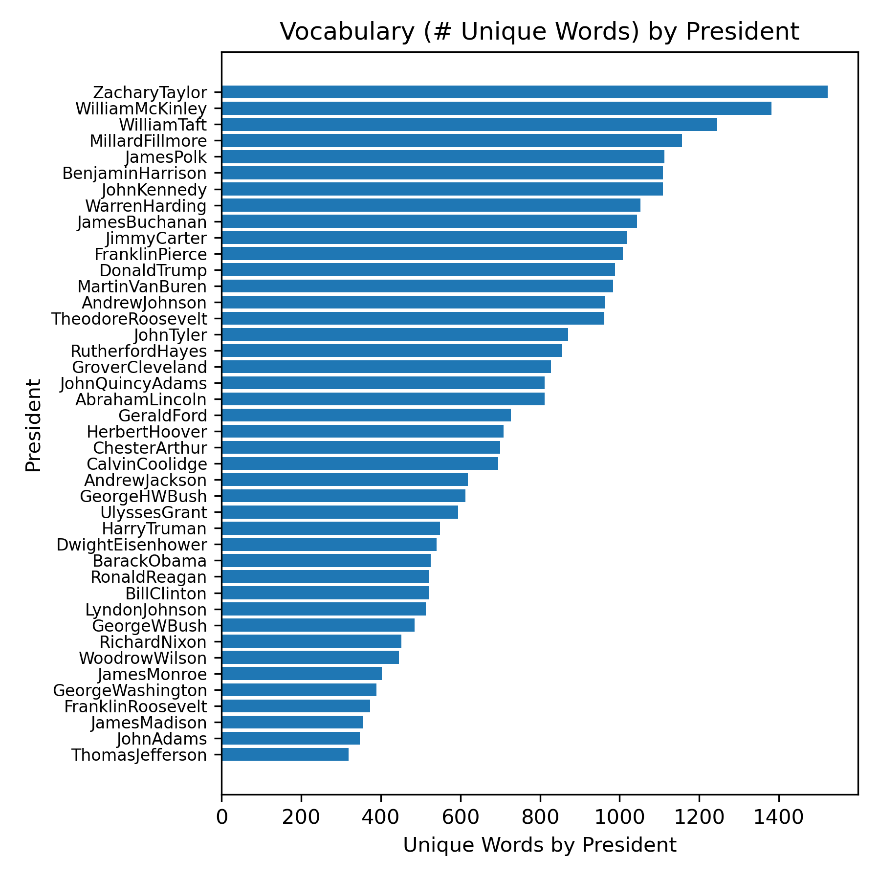
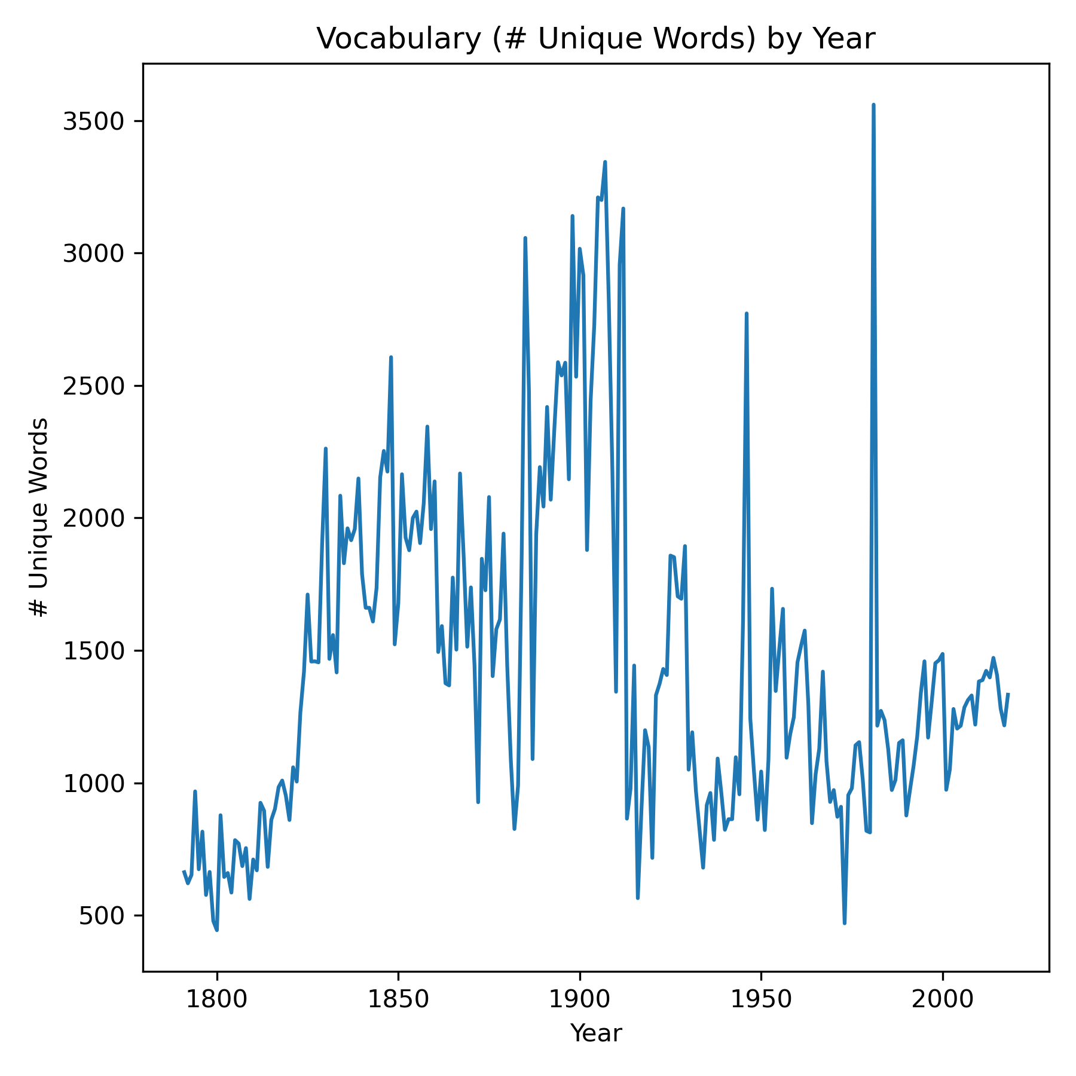
Results
Which presidents used the most unique words?
Zachary Taylor takes the cake!
McKinley, Taft, Fillmore all at top
Around 1900’s the speeches seemed to increase in verbosity
Which presidents used the least unique words?
Early presidents had very small vocabularies
Washington, Adams, Jefferson, Madison

Slide 12
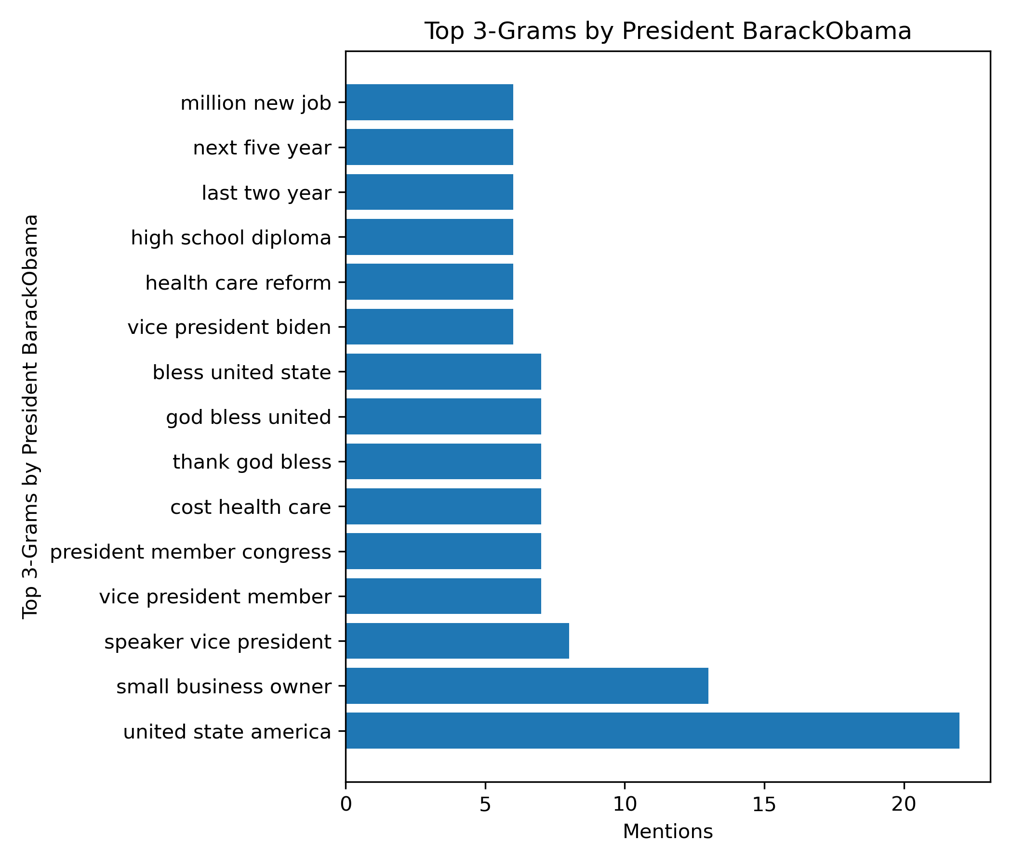
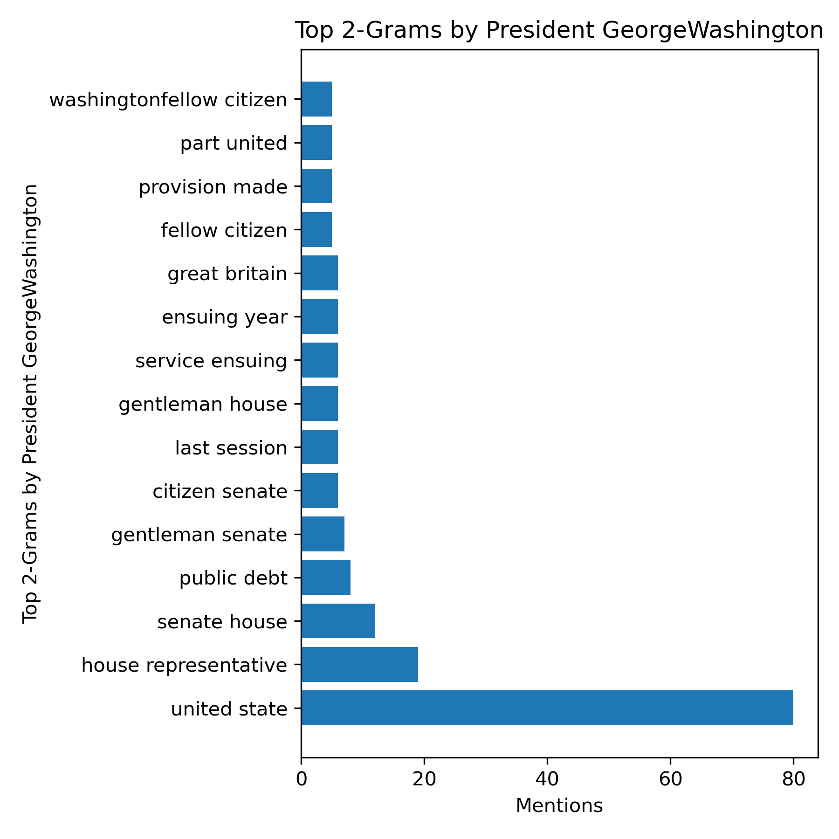
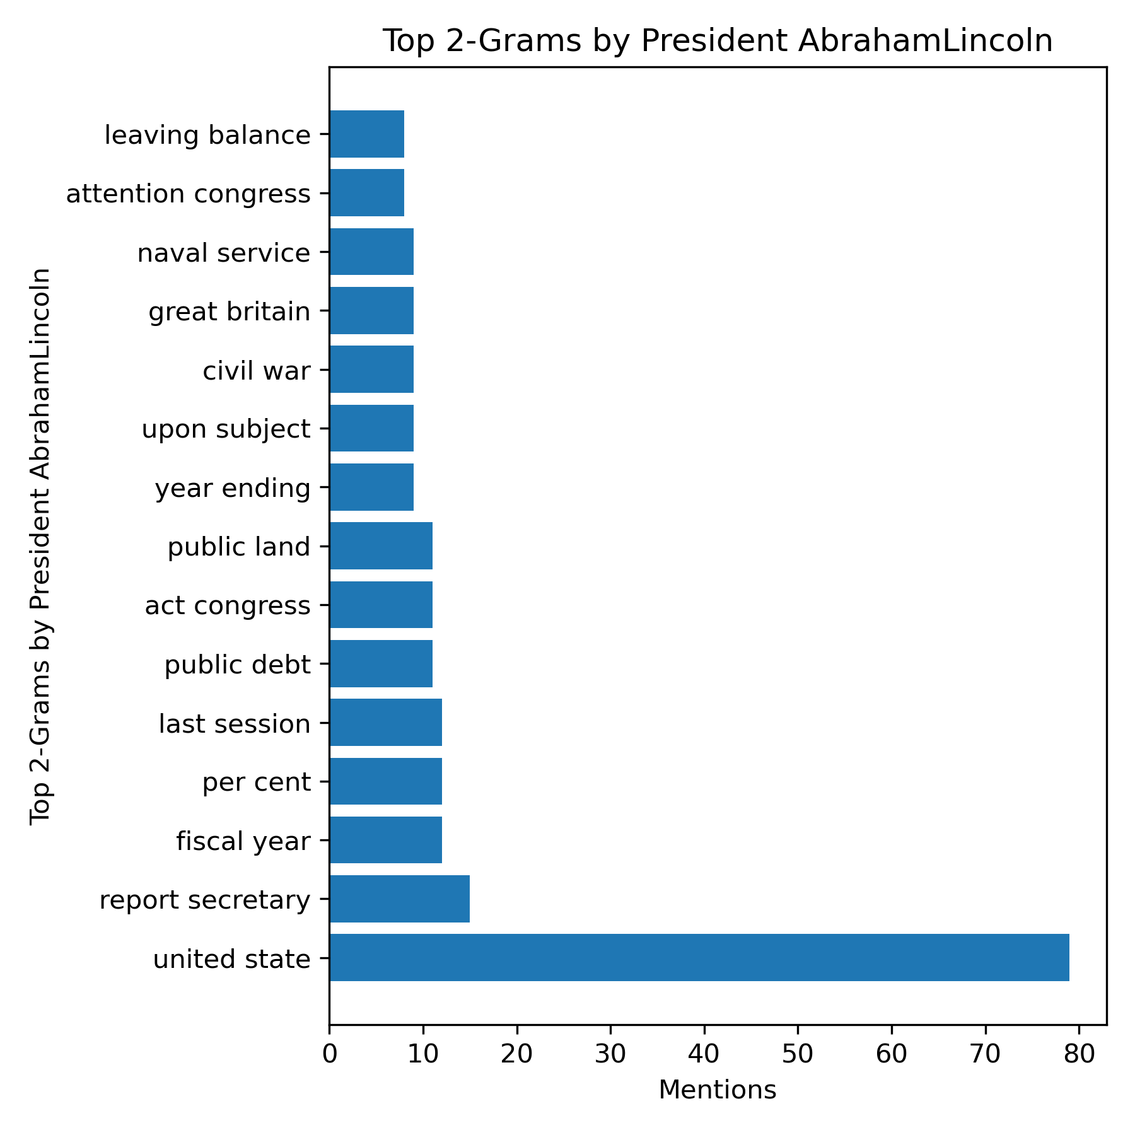
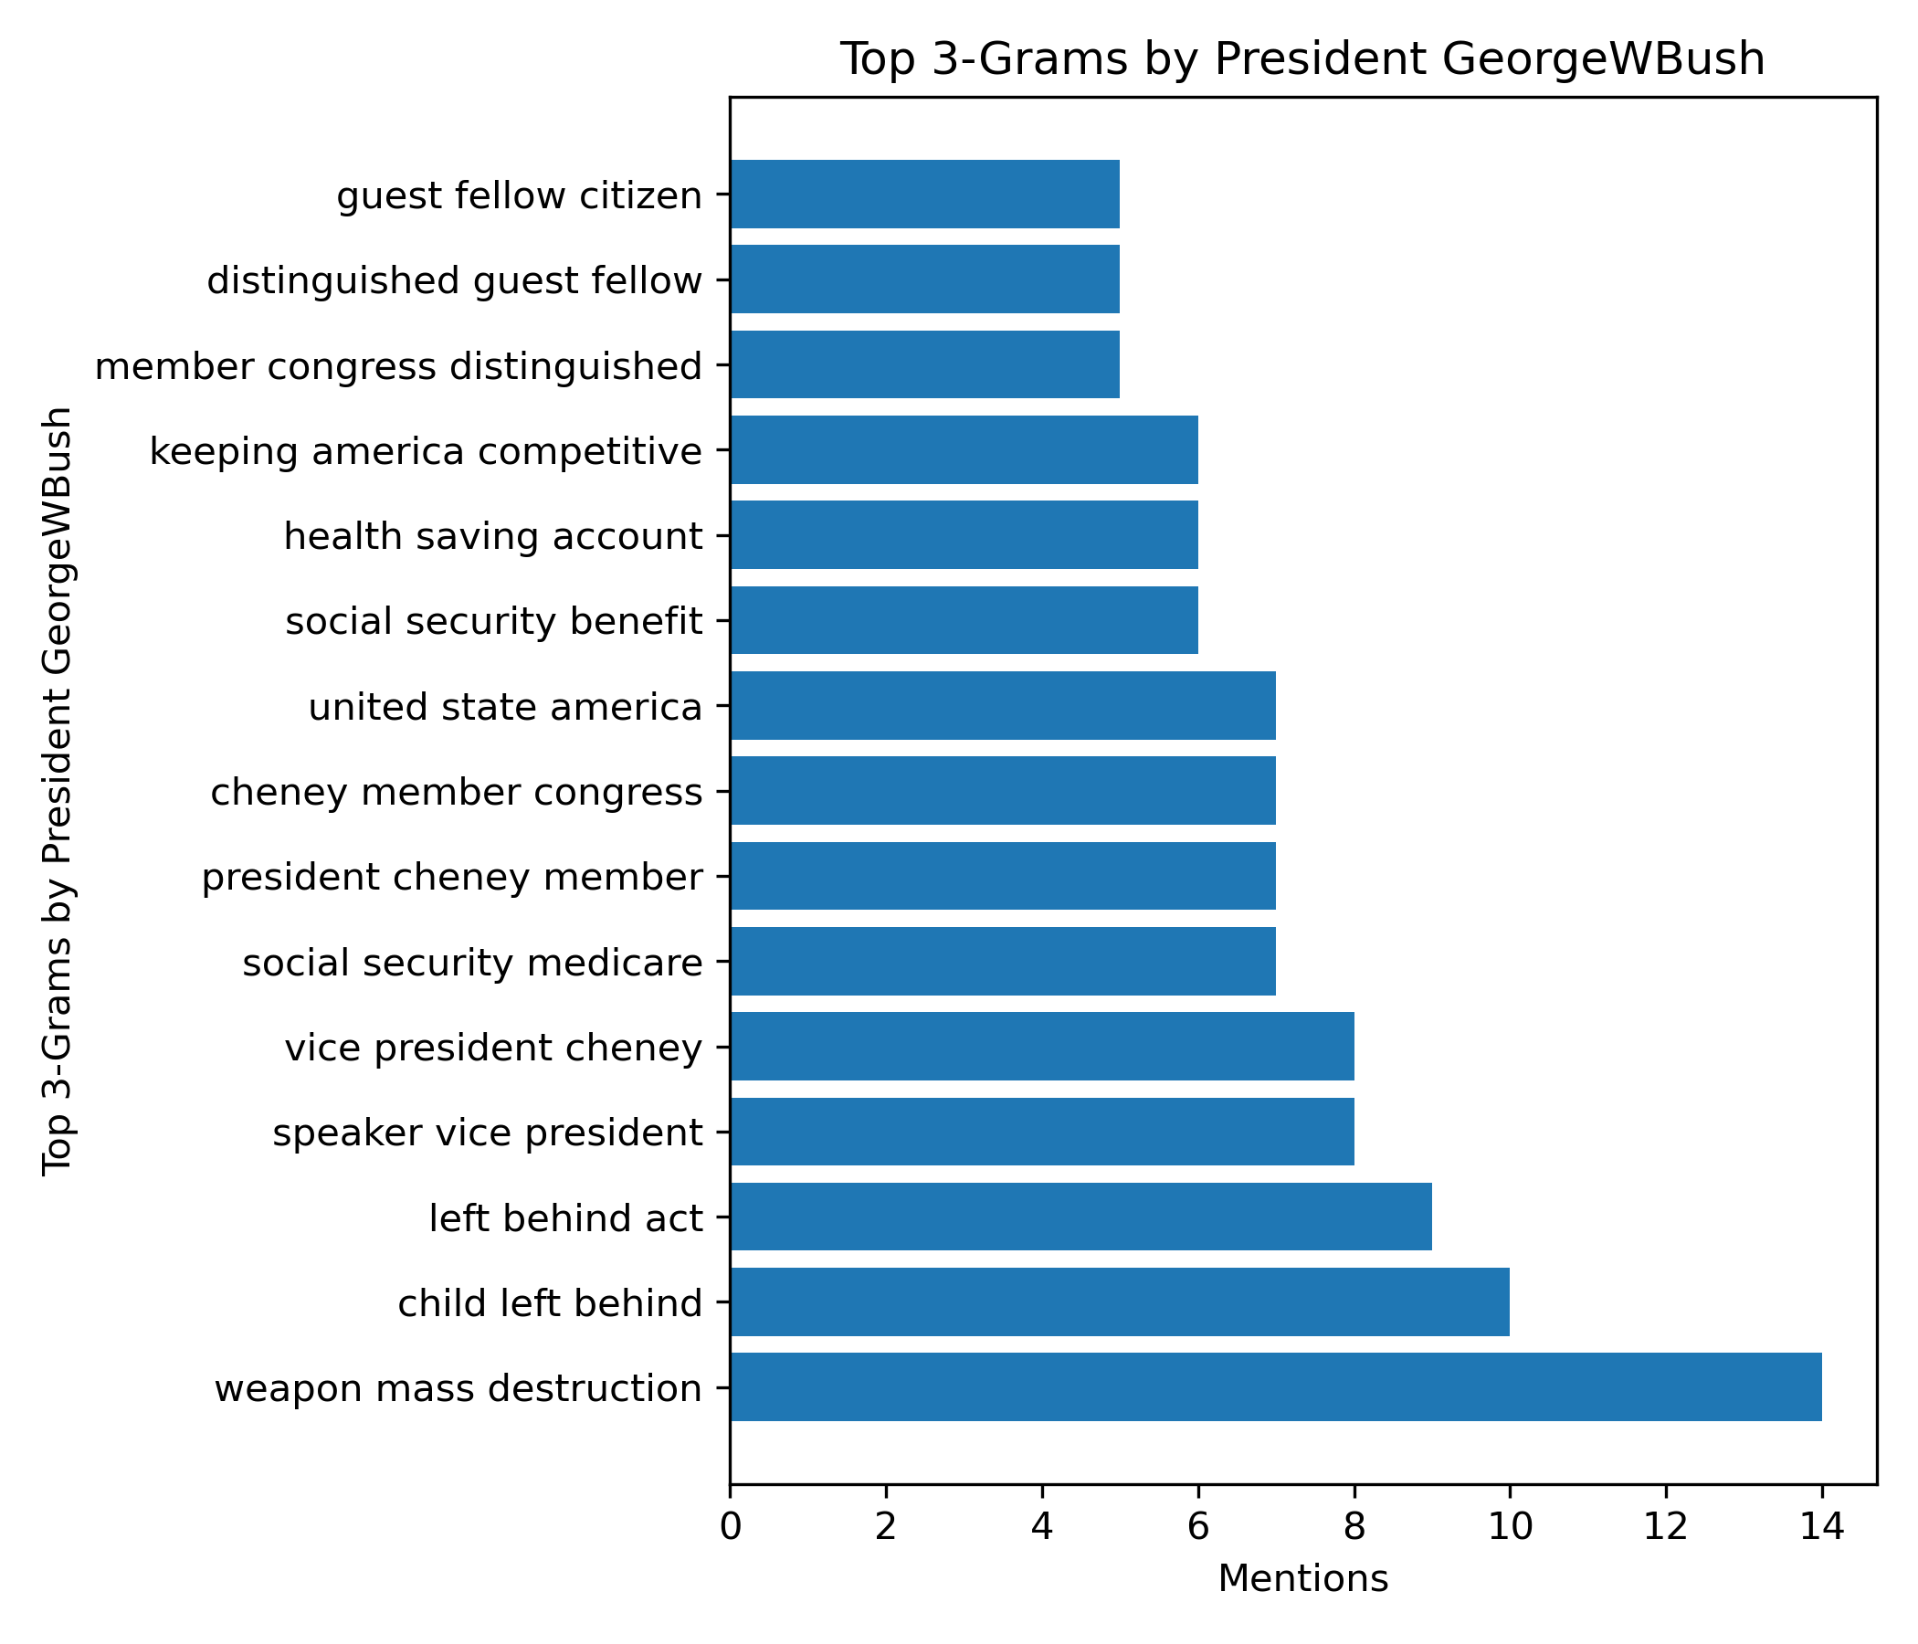
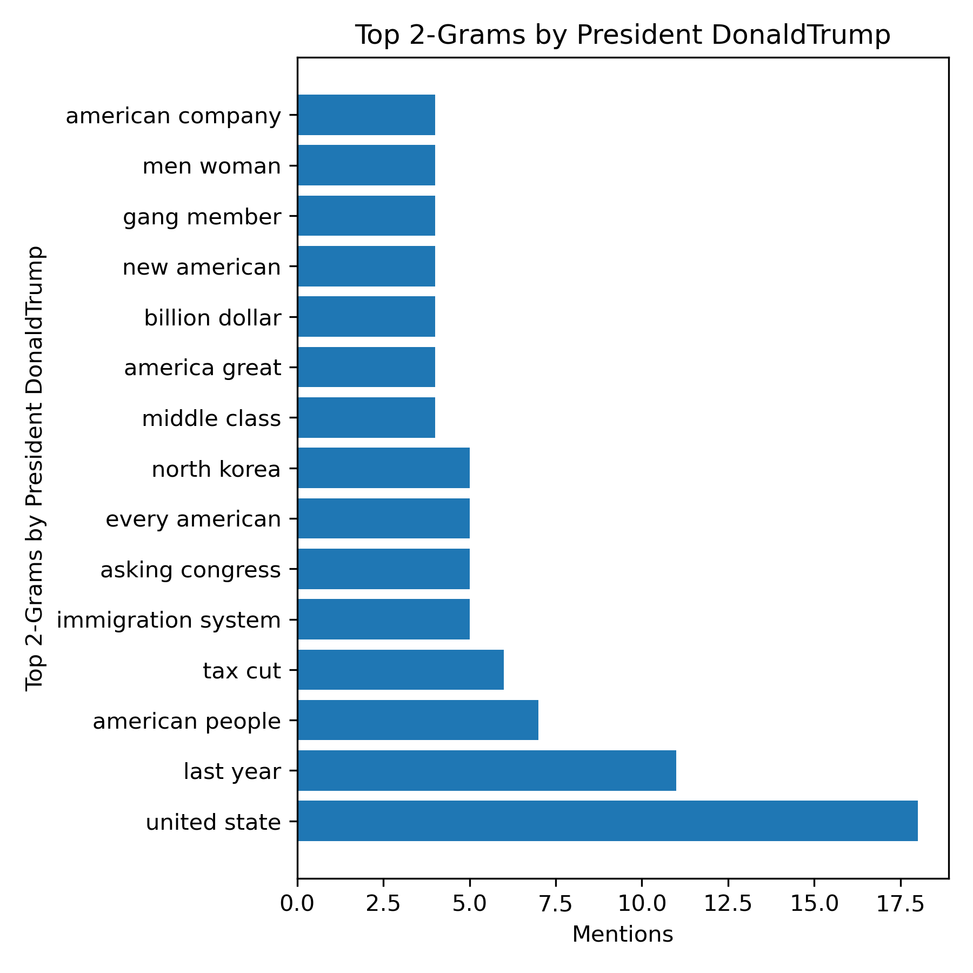
Results
What are the themes or buzzwords among the different speeches / presidents?
What were the most common words used in each speech?

Slide 13
Conclusion
All questions were answered!
Early presidents had very brief SOTU addresses
No mass communication except newspapers, where brevity was preferred
Not as well-defined tradition
Government was more limited, less responsibilities to report on
Presidents around the year 1900 had much lengthier speeches than today
Presidents in general gave less speeches per year back then, SOTU was more significant
Main mediums of mass communication then were newspaper, radio, in-person speeches
2-grams were most successful in summarizing a president’s speech
1-grams: not enough information
3-grams: not enough frequency of terms, inconclusive lists
All sentiments/polarities were positive among the presidents
Makes sense, president should have a positive tone
Year 6 was the most positive year among all presidents, on average
Year 2-3 was the least positive year among all presidents, on average
Recent Republicans tended to be more positive than recent Democrats

Slide 14
Future Work
This project was a huge learning experience for me!
Project selection in the beginning could have been better
State of the Union speech = very formal address, generally
Differences aren’t as noticeable
Actions going forward for this project:
Focus on ONE individual, develop prediction algorithm for that individual
Source more informal text sources
Create more interactive visualizations
More variety needed
Actions going forward for next capstone:
Focus on more numerical data
Involve more prediction elements
Cater more towards a business need (rather than personal curiosity)

Slide 15
Project Tips and Tricks
I recommend taking a look at the ‘output’ directory within my github repository! https://github.com/jeremyabeard5/MSDS692
Has all 1-gram, 2-gram, 3-gram figures
Over 500 figures!! Pick your favorite president ☺ too much to include in an appendix
Has console_output.txt if one is curious in the logged output statements
The ‘data’ directory within my github has all the original speeches
Reach out if you have any questions or ideas!

Slide 16
Thank You

Slide 17
References
Jeremyabeard. (n.d.). GitHub - jeremyabeard5/MSDS692: Final project 1: Presidential Sentiment Analysis! GitHub. https://github.com/jeremyabeard5/MSDS692
Matplotlib — Visualization with Python. (n.d.). https://matplotlib.org/
Schnell, M. (2023, February 8). The Hill. The Hill. https://thehill.com/homenews/administration/3848854-the-five-biggest-moments-from-bidens-state-of-the-union-address/
State of the Union Corpus (1790 - 2018). (2018b, October 19). Kaggle. https://www.kaggle.com/datasets/rtatman/state-of-the-union-corpus-1989-2017

